Slide 1

AI DRIVEN AUTONOMOUS STEERING USING IoT AND ML
Ayush Gupta-(22106074) Anthony Chavez-(22106038) Krishna Dongre-(22106089) Sumedh Gadpayle-(22106076)
Project Guide
Dr. Tejashri Kolhe

Slide 2
Outline
Introduction
Literature Survey of the existing systems
Limitations of the existing systems
Problem statement and Objective
Proposed System
Experimental Setup
Implementation
Conclusion and future work
References

Slide 3
Introduction
This project aims to develop a basic autonomous steering control system that uses a trained deep learning model to predict steering angles from video input and physically actuates the steering mechanism using a stepper motor controlled via an Arduino. The project serves as the foundation for a larger autonomous driving platform, where future components like braking, acceleration, and object detection will be added. In alignment with the United Nations Sustainable Development Goals (SDGs), this project supports SDG 9 (Industry, Innovation, and Infrastructure) by fostering innovation in intelligent vehicle systems and low-cost automation; SDG 11 (Sustainable Cities and Communities) by contributing to safer and more efficient urban mobility. Additionally, the project’s potential integration with electric and energy-efficient systems aligns with SDG 13 (Climate Action), promoting sustainable transportation and reduced carbon impact.

Slide 4
Literature Survey of the existing system
Year | Title | Domain | Algorithm | Dataset | Gap
2024 | Arduino based stepper motor speed regulation for robotics applications | Robotics / Motor control / Power electronics | C l o s e d - l o o p control using Park Transformation with hybrid two- phase model; | Experimental & simulation data: motor source voltage, current, speed, torque; hardware implementation. Speed range: 0 to ~6000 (units presumably pulses or rpm) | Possibly limited: didn’t compare with other advanced control methods (e.g. adaptive, fuzzy, neural). Also speed highest of 6000; behavior at very high speed or under load variation maybe not tested.
 | [Golluri Ramcharan and Dhunnapothula Raghu ] |  | simulation in MATLAB/Simulin k + hardware with
 |  |  | Arduino.

Slide 5
Year | Title | Domain | Algorithm | Dataset | Gap
2023 | Designing and Crafting Stepper Motor Position Control with Arduino Mega 2560 by - [ Dr. Ruchi Pandey, Anand Goswami, Uttam Lal Yadav, and Yogesh Vishwakarma] | Robotics / Position control / Embedded Control | Position control using Arduino Mega 2560 + Rotary Encoder feedback; likely closed-loop control. | Experimental: synchronous control of two stepper motors; using position feedback via encoder; testing for accuracy in position control. | probably limited to simple position control (no load disturbance analysis, speed‑vs‑accuracy trade-offs maybe not explored). Also, likely no large dataset; only “real requirements” as per specific hardware, no comparative benchmarks. May lack robustness to change in load or external disturbances.

Slide 6
Year | Title | Domain | Algorithm | Dataset | Gap
2023 | The Prototype | Remote / auxiliary steering gear demo; maritime ships auxiliary machinery control | Research & Development procedural model; uses ESP8266 module for WiFi, Servo Motor for steering direction/angle; control via smartphone app; microcontroller logic. | Hardware prototype: stepper motor + driver; experimental motion of archery drawer; no standardized dataset; measurements are likely mechanical movement, angle, perhaps tension. | algorithmic detail lacking; no feedback control or closed‑loop; performance under real archery loads, durability, safety not explored; precision, repeatability under load or over many cycles not well documented.
 | Electric Steering
 | Gear Based
 | Microcontroller
 | Arduino
 | [Amad Narto,
 | Suharto Suharto,
 | and Regga Diko
 | Catur ]

Slide 7
Year | Title | Domain | Algorithm | Dataset | Gap
2023 | Low‑cost autonomous car level 2: Design and implementation [ARM Khairudin] | Autonomous vehicles / driver assistance / automation | Probably uses sensor fusion, planning & control methods; but specific algorithm details not found in summary. Could include vision, steering control, path planning. | Experimental prototype; sensors, hardware; no public large dataset info; likely own collected test trials. | Level‑2 autonomy is partial; likely limited test environments; generalization to varied roads/weather not established; reliability / safety not deeply validated.

Slide 8
Limitations of Existing Systems
High Cost – Commercial autonomous vehicle systems are expensive, restricting access for students, researchers, and small developers
Complexity – The integration of multiple advanced sensors and algorithms makes these systems difficult to prototype or replicate.
Proprietary Nature – Most solutions are closed-source, limiting customization, experimentation, and academic learning.
Hardware Requirements – Dependence on specialized and costly components increases barriers to entry.
Scalability Issues – Existing platforms are not modular, making it hard to expand or adapt them for educational or small-scale use.
Limited Accessibility – Lack of affordable, open platforms prevents widespread participation in autonomous vehicle research and innovation.

Slide 9
Problem statement
Self-driving technologies are often expensive, complex, and proprietary, making them inaccessible for students and small developers. There is a lack of affordable, modular platforms to test key functions like steering, braking, and object detection. This project addresses the gap by creating a low-cost, scalable system using accessible components such as Arduino, stepper motors, and AI-based angle prediction, making autonomous vehicle research more inclusive and practical..

Slide 10
Objective
Design and implement a low-cost autonomous steering control system that integrates deep learning, computer vision, and embedded hardware to replicate human driving behaviour.
Train a Convolutional Neural Network (CNN) on video datasets converted into frames, enabling the system to analyse road visuals and predict steering angles in real time.
Translate CNN predictions into physical steering actions using an Arduino-controlled stepper motor attached to a steering wheel setup.
Ensure accuracy and reliability of the system by incorporating speed control and noise filtering mechanisms for smooth steering performance.

Slide 11
System Design
Input from video input
Fed to CNN model
Predicts steering angle
Inputs to Arduino
start
Operates the actuators
end

Slide 12
Technologies and methodologies
A CNN model – Processes video input to predict the steering angle based on road patterns.
Arduino Mega controller – Acts as the bridge between software commands and physical motor actions.
Stepper motor and motor driver – Controls precise rotation of the steering wheel based on predicted angles.
A power supply – Provides stable voltage and current to all electronic components.
Actuators (steering) – Convert electrical signals into mechanical movement for vehicle control.

Slide 13
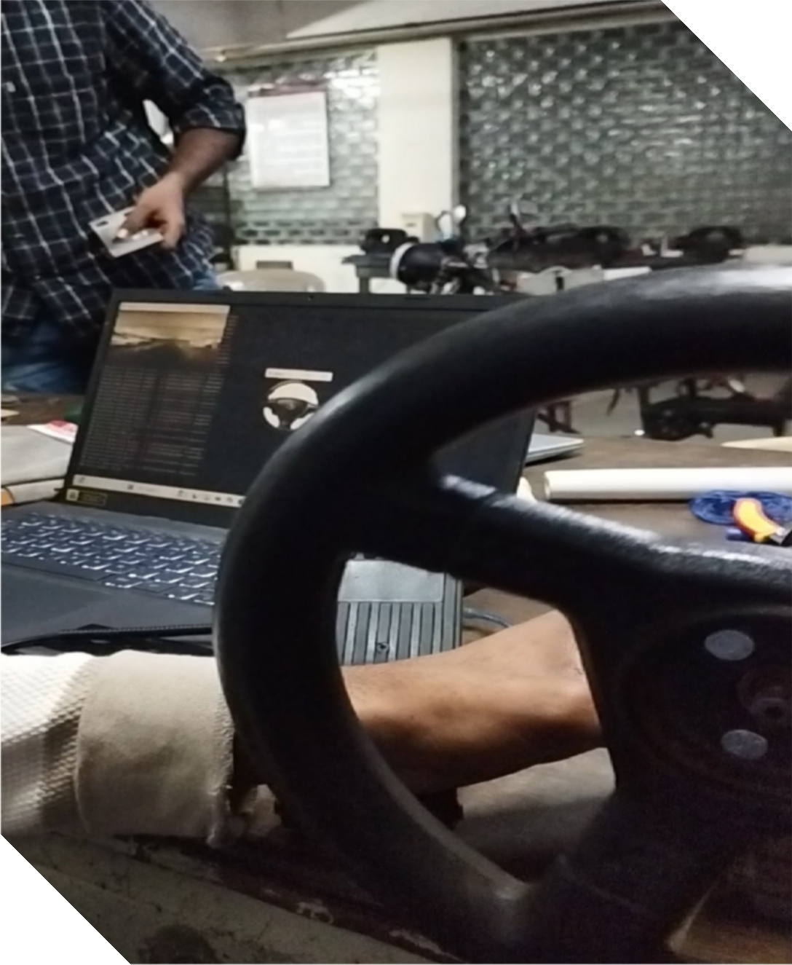
Implementation

Slide 14
Expected Outcome
A working prototype of an auto-steering system using Arduino and a stepper motor.
Accurate translation of AI-predicted steering angles into mechanical steering control.
Demonstration of a low-cost, modular, and scalable approach to autonomous vehicle systems.
A learning and research platform for students, developers, and researchers.
Foundation for future integration of braking, acceleration, and object detection modules.

Slide 15
Conclusion
This project demonstrates a low-cost and modular auto-steering system using Arduino and a stepper motor, showing that autonomous steering can be achieved with accessible hardware. The prototype effectively translates predicted steering angles into precise control, offering a scalable platform for learning and research in autonomous electric vehicles. While limited to steering, the system lays the foundation for future integration of braking, acceleration, and perception modules, making autonomous vehicle development more affordable and inclusive.

Slide 16
References
Golluri Ramcharan and Dhunnapothula Raghu, “Arduino based stepper motor speed regulation for robotics applications,” 2024, ResearchGate (conference/article preprint).
Dr. Ruchi Pandey, Anand Goswami, Uttam Lal Yadav, and Yogesh Vishwakarma, “Designing and Crafting Stepper Motor Position Control with Arduino Mega 2560,” Feb. 2023, International Journal Of Innovation In Engineering Research & Management.
Amad Narto, Suharto Suharto, and Regga Diko Catur, “The Prototype Electric Steering Gear Based Microcontroller Arduino,” 2023, RSF Conference Series: Engineering and Technology, v.3 i.1.
ARM Khairudin, “Design of Stepper Motor Application as Archery Drawer,” 2023, Perintis e-journal.

Slide 17
M. S. Mohammed et al., “Low-cost autonomous car level 2: Design and implementation,” 2023, ScienceDirect.
“Development of Four-Wheel Steering (4WS) with Arduino-Controlled Stepper Motor,” Nov. 2022, International Journal/Conference Paper.
“Development of Steering Control System for a Small Electric Vehicle,” Nov. 2022, YMER Digital.
“Electronic Hardware Design of An Autonomous Vehicle,” 2020, IJERT.
A. Rossi, N. Ahmed, S. Salehin, T. Hasnine Choudhury, and G. Sarowar, “Real-time Lane Detection and Motion Planning in Raspberry Pi and Arduino for an Autonomous Vehicle Prototype,” Sep. 20, 2020, arXiv preprint arXiv:2009.09391.
R. Thrun et al., “Stanley: The Robot that Won the DARPA Grand Challenge,” 2006,
Journal of Field Robotics.

Slide 18
Thank You...!!

